Slide 1
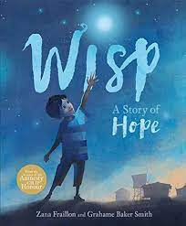
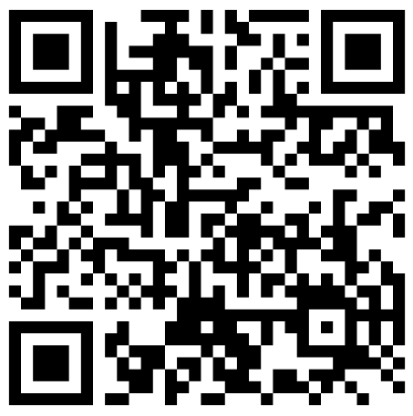
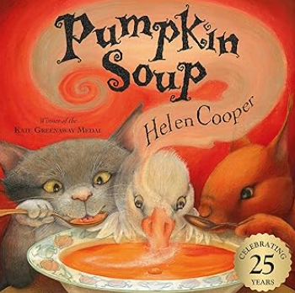
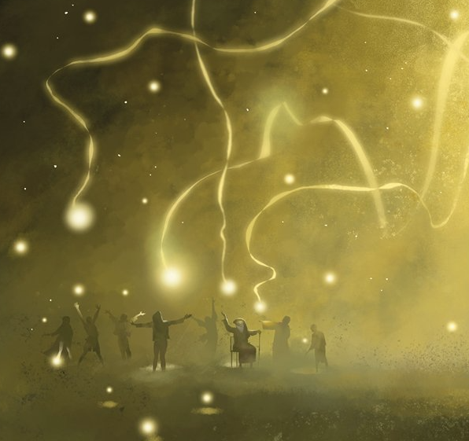
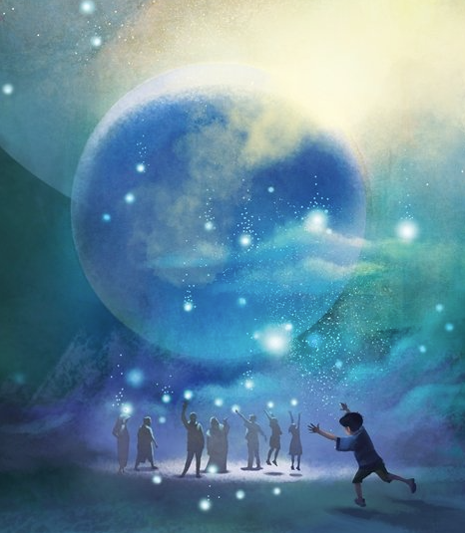

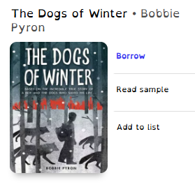
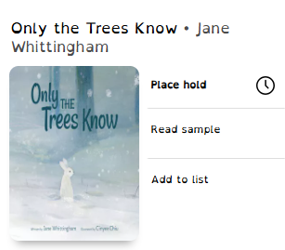
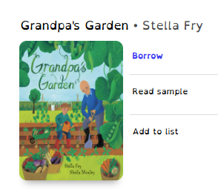
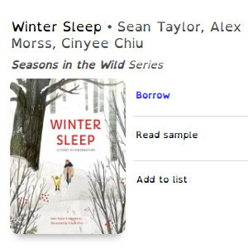

This page is a bank of ideas and resources to help you and your child get a head start before we begin our new topic, A Winter’s Wisp in Autumn 2.
From simple activities and interesting reads to places you could visit or things to watch together, these suggestions are designed to spark curiosity and excitement. It’s a great way to ease into the topic and start making connections at home before we dive in at school. Have fun exploring!
Things to watch!
Why not try…
BBC Bitesize
Inside out (PG)
Song of the Sea (PG)
Paddington (U)
Why not try…
Creating your own pumpkin soup!
Design a Winter scene.
Illustrate what magic looks like.
Find me on SORA!
Ingredients, recipe, utensils, ladle, saucepan, simmer
New tier 3 vocabulary!
⭐ How to Get a Blue Peter Reading Badge:
Read at least 3 books of your choice – they can be fiction, non-fiction, poetry or even graphic novels!
Write about them – say what you liked, who your favourite characters were, or what you learned. (Just a few sentences is fine).
Send your form to Blue Peter – either by post or by uploading it to the BBC website (you’ll need a grown-up to help with this part).
🔗 Apply online or find full instructions here: Blue Peter - https://www.bbc.co.uk/cbbc/findoutmore/blue-peter-apply-for-a-book-badge
Once your application is approved, your child will receive their very own Reading Badge in the post!

